Slide 1


A product extension idea
-Vaishnavi Arni

Slide 2

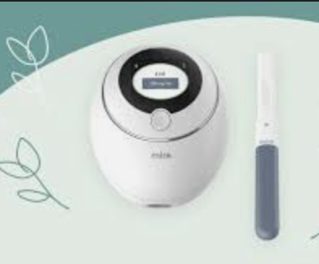
Infertility and Mental Health
Various studies have shown that going through fertility treatments and experiencing infertility can be one of the most challenging periods of one’s life.
Anxiety, depression, and psychological turmoil are some of the mental health issues that affect women facing issues with fertility and conception.
Women of color might be more likely to be blamed for their own infertility or have their emotional pain and valid medical concerns dismissed or ignored by a physician.

Slide 3

PCOS and Mental Health
We are also aware that PCOS is associated with and increase risk of diagnosis of depression, anxiety, bipolar disorder, and obsessive-compulsive disorder
Screening for these disorders to allow early intervention may be warranted
Apart from the above, stress is an invisible factor that is affecting the lives of modern women and is strongly associated with PCOS

Slide 4
Why do we need a new product extension / feature?
Now, Mira is providing a one-stop platform for ovulation, periods, and hormone tracking with access to blogs and newspaper articles to access information related to the primary subject.
With the information that we have gathered in the previous slides, it is important for us to create a platform for women dealing with infertility and other issues to be able to connect with each other and be able to reach out for help whenever they need to.

Slide 5

New Feature Idea 1 - Companion
Companion can be a platform within Mira where people can connect with others going through the same issues anonymously or otherwise with the help of discussion boards
Like reddit, you can have a platform within Mira where users can post about various topics with the option of others being able to comment and add to the discussion and share their experiences
The main aim here is to provide people a space space to voice their thoughts and to share their journey with others in the same boat.

Slide 6

Pros of developing Companion
Users do not have to look for other apps like Discord, Twitter, Reddit etc, to find people to talk about their journey, and share useful information
The engagement rate of the app increases as this feature would connect people
This feature would be unique to Mira as there is no other app offering a platform for woman going through fertility issues to connect
As this would be a unique feature, we can advertise it to increase brand awareness and brand recognition

Slide 7

New Feature Idea 2 - Hero
Hero can be a platform where people struggling to cope with infertility and PCOS can reach out to trained and licensed professionals who can provide mental health support, and therapy. They can be psychiatrists and therapists.
The appointment can be scheduled in-person or online as per the user’s convenience and preference and the availability of the professional
Type of Help: Online, In-person, Text Chat, Phone Calls
This can be done in two ways:
Partnering with apps that provide mental health support like BetterHelp, Headspace, and Teladoc Health
Develop a system which connects people to online therapy and where they can schedule appointments with a mental health professional

Slide 8
Factors to consider while developing the new features
Both the suggested features will need to have separate protocols and regulations which will require additional investment
With the additional features, the competitors for the app will also increase which will include competitors from other industries
As the additional feature is a product extension, the UI and UX will have to be designed from scratch and will require technological, financial, medical, and scientific backing and upkeep.
Marketing and Promotions for the new features
Survey the existing customers to review the new features and make improvements

Slide 9
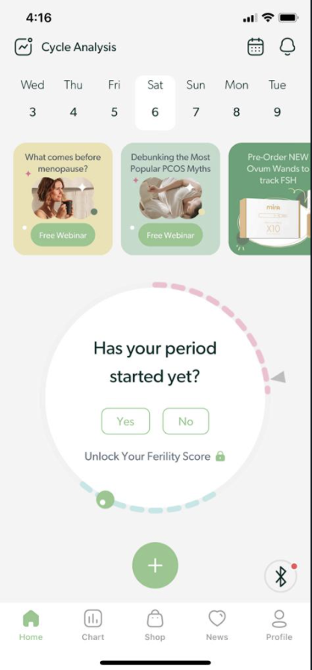


UI Placement of the new features
The ”Hero” product extension is placed on the top-right corner of the app next to the Calendar and notifications
The ”Companion” feature of the app is located right above the Home icon
Clicking on the Hero feature will give you options to talk to a professional, chat with a live therapist or book appointments online, clicking on any of these options will open a new UI as per the selection made.
Clicking on the Companion logo will open a UI like Reddit where the user can browse through articles posted by users and add to the discussion whenever they feel relevant.

Slide 10
References
Cedar Sinai – Infertility and Mental Health - https://www.cedars-sinai.org/blog/infertility-mental-health.html
Mayo clinic - https://www.mayoclinic.org/diseases-conditions/female-infertility/symptoms-causes/syc-20354308
National Library of Medicine - https://pubmed.ncbi.nlm.nih.gov/30066285/#:~:text=Conclusions%3A%20PCOS%20is%20associated%20with,early%20intervention%20may%20be%20warranted.
Healthline - https://www.healthline.com/health/depression/pcos-and-depression
CDC - https://www.cdc.gov/reproductivehealth/depression/index.htm

